Slide 1


.
Bangalore Institute of Technology
K.R. Road, V V Puram, Bangalore-560004
Department of Electronics and Communication Engineering
Technical Seminar Presentation
on
“Toward 5G Edge Computing for Enabling Autonomous Aerial Vehicles”
SANDESH G NAIK 1BI20EC127
Technical Guide:
Mr. GAHAN A V
Assistant Professor
Dept. of ECE
BIT Bangalore
Head of the Department:
Dr. HEMANTH KUMAR A R
Professor and Head
Dept. of ECE
BIT Bangalore

Slide 2
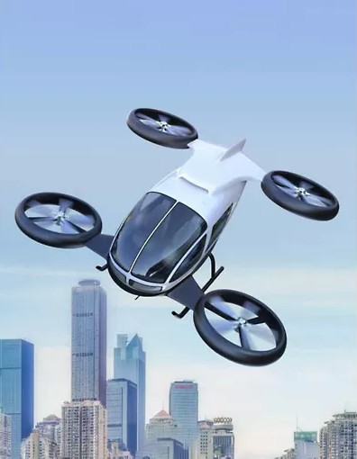
Introduction
Literature Survey
Architecture
Methodology
System Design Flow
Application
Conclusion
References
Contents

Slide 3
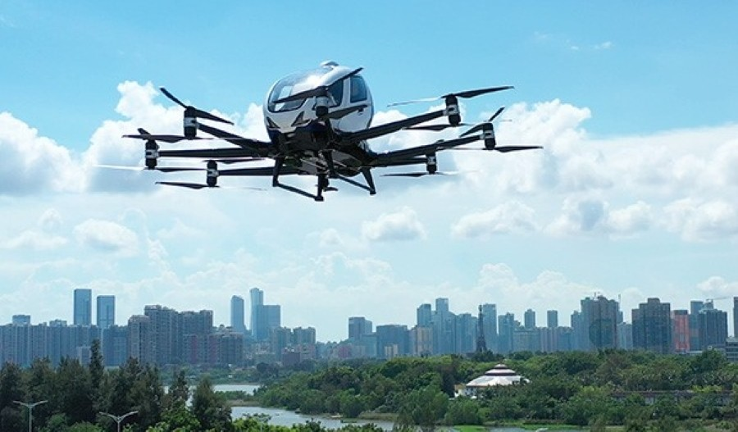
INTRODUCTION
AAVs (drones) are increasingly used across industries and research due to their flexibility and capabilities.
Autonomous aerial vehicles (AAVs) have great potential for many applications, such as delivery or surveillance.
To be fully autonomous, UAVs need fast, reliable communication for decision-making.
5G networks offer low latency and high data speeds, perfect for UAV control.
Edge computing brings processing power closer to UAVs, reducing delays and improving responsiveness.

Slide 4
LITERATURE SURVEY
SL.NO | Title of the paper | Year | Author | Learning Outcome
1. | A survey on vision-based UAV navigation | 2022 | Y. Lu, X. Zhucun, G.-S. Xia, and L. Zhang | This paper explains how sensors visual data is used for navigation tasks such as obstacle avoidance and also explains path planning.
2. | Artificial intelligence for wireless caching | 2021 | M. Sheraz, M. Ahmed | This paper focus on understanding the role of AI in enhancing the efficiency and effectiveness of caching mechanisms in wireless communication environments.

Slide 5
LITERATURE SURVEY
SL.NO | Title of the paper | Year | Author | Description
3. | PACED-5G: predictive autonomous control using edge for drones over 5G | 2023 | Anirudh paranjothi, mohammed shaquib | This paper focuses on edge architecture and UAV modeling for enhancing the modeling and reducing latency .
4. | Communication-aware control of large data transmissions via centralized cognition and 5G networks | 2020 | Mohammed shaquib, ioannis krikidis | This paper focuses on optimizing data transmission processes by AI and leveraging centralized decision-making.

Slide 6
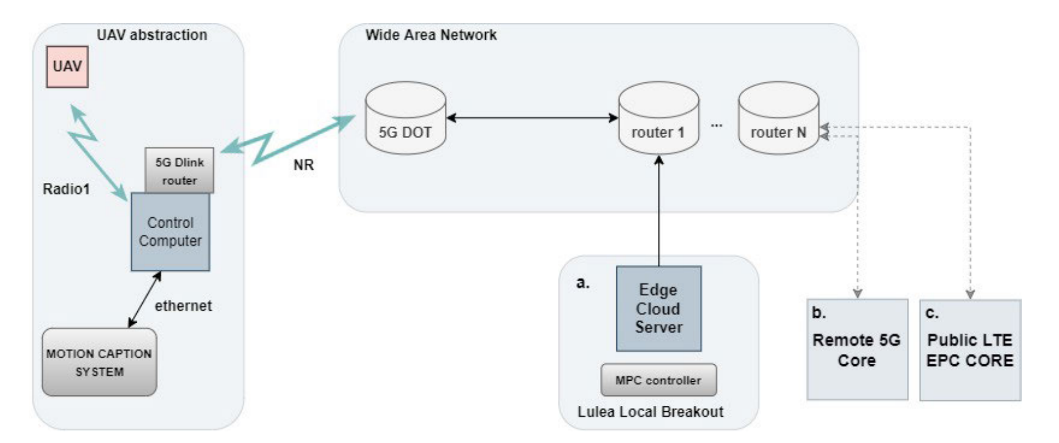
ARCHITECTURE
FIGURE : System architecture for the UAV communication over 5G to the edge server.
The Local 5G & Edge Cloud is used and the MPC controller is hosted on the edge cloud server.
The 5G with remote core & Cloud, all the control loop data has to pass through the remote 5G core.
The Public LTE & Cloud, all the control loop data has to pass through the public LTE core.

Slide 7
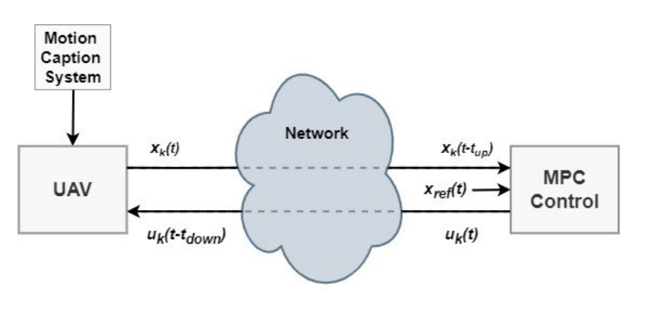
METHODOLOGY
The block labeled “Motion Caption System” refers to the system that measures the UAV’s position and motion. This system likely includes sensors such as accelerometers, gyroscopes, and GPS.
The block labeled “Xk(t)” refers to the state of the UAV at time t. This state includes information such as the UAV’s position, velocity, and acceleration.
The block labeled “Xref(t)” refers to the desired state of the UAV at time t. This is the reference signal that the control system will try to follow.
The block labeled “uk(t)” refers to the control input to the UAV at time t. This is the signal that is sent to the UAV’s actuators (such as its motors) to control its motion.
The block labeled “Network” refers to the communication channel between the edge server and the UAV. There may be a delay (denoted by “tdown” in the image) in the signal traveling from the edge server to the UAV, and another delay (denoted by “tup” in the image) in the signal traveling from the UAV to the edge server. These delays can be caused by factors such as the distance between the edge server and the UAV, and the processing time of the sensors and actuators.
Fig: Edge server oriented proposed closed loop control architecture.

Slide 8
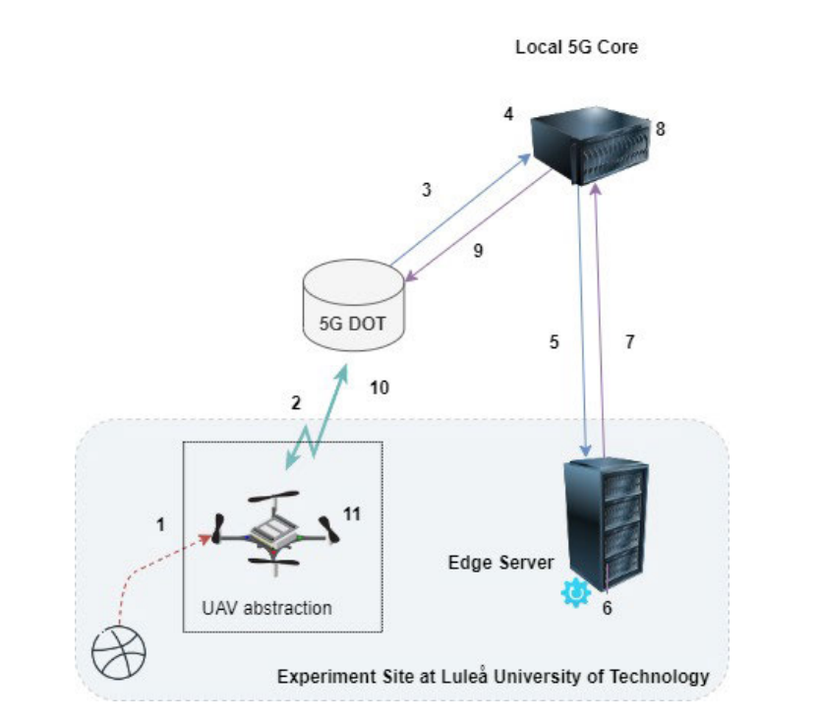
SYSTEM DESIGN FLOW
Capturing Data: Sensors on the UAV measure its state and the position of obstacles.
Sending Data to Base Station: Sensor data is sent from the UAV to the edge server via a base station using 5G NR.
Base Station to Local Core: The base station relays the data to the local 5G core network.
Local 5G Core Breakout: Data reaches the local core breakout, which routes it to the edge server.
Data Arrives at Edge Server: The data arrives at the edge server where the NMPC software makes a control decision.
Decision Making at Edge Server: The NMPC decides on an action (continue path or avoid collision) and sends a control command.
Sending Control Commands: The control command is sent from the edge server back to the UAV through the local core breakout.
Local Core Breakout to Serving Base Station: The core network routes the control commands to the serving base station.
Base Station to UAV: The serving base station transmits the control commands to the UAV.
UAV Receives: The UAV receives the control commands from the base station.
Taking Action: The UAV software translates the commands into actions to control its movement.
FIGURE 9. Complete data flow regarding the collision avoidance use-case.

Slide 9
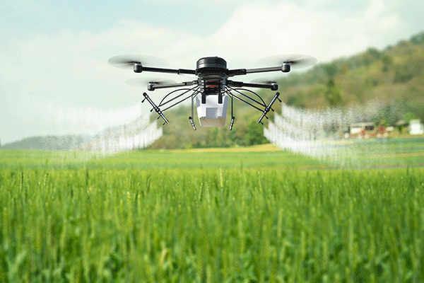
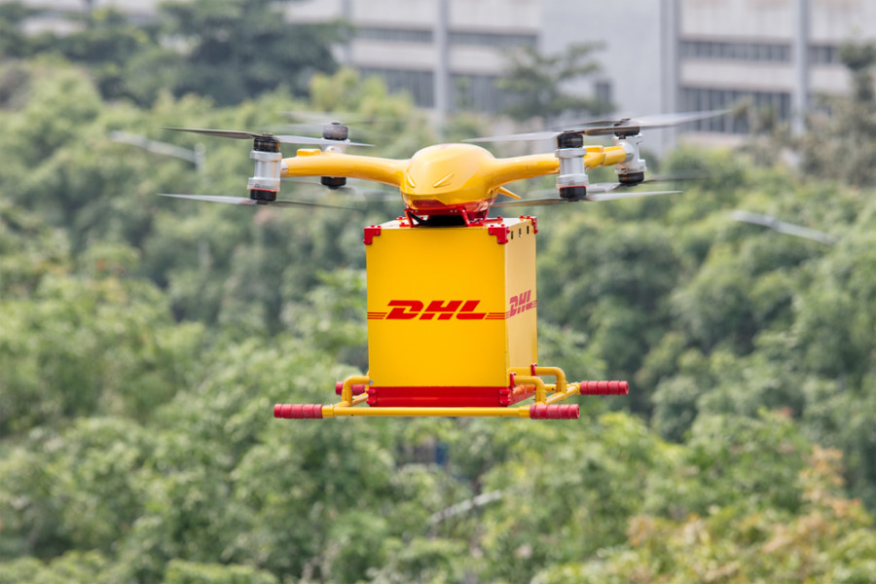
APPLICATION
Precision Agriculture: Drones equipped with AI can be used to collect and analyze data on crop health, soil moisture, and other environmental factors.
Surveillance and Security: AI can be used to analyze the video footage captured by drones to detect and identify suspicious activities or objects, such as potential intruders, stolen vehicles, or lost items.
Disaster Response: During natural disasters, drones can be deployed to gather real-time data on the affected areas, such as the extent of flooding or damage to buildings.
Delivery Services: Companies like Amazon and Google are already exploring the use of drones for package delivery.
Environmental Monitoring: Drones equipped with sensors and AI can be used to collect data on air and water quality, as well as wildlife populations and habitat conditions.

Slide 10
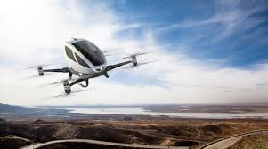
CONCLUSION
5G-enabled UAV control with edge computing is demonstrated to be feasible and effective for autonomous missions.
Local 5G & Edge architecture provides the lowest latency, making it ideal for time-critical UAV applications.
Network load and architecture significantly impact the performance and predictability of UAV control systems.
The proposed architecture offers performance comparable to onboard computation, highlighting the potential of offloading control to external resources

Slide 11
REFERENCES
[1] Y. Lu, X. Zhucun, G.-S. Xia, and L. Zhang, ‘‘A survey on vision-based UAV navigation,’’ Geo-spatial Inf. Sci., vol. 21, no. 1, pp. 1–12, ___Jan. 2018.
[2] M. Sheraz, M. Ahmed, X. Hou, Y. Li, D. Jin, Z. Han, and T. Jiang, ‘‘Artificial intelligence for wireless caching: Schemes, performance, ___and challenges,’’ IEEE Commun. Surveys Tuts., vol. 23, no. 1, pp. 631–661, 1st Quart, 2021.
[3] M. Y. Arafat and S. Moh, ‘‘Bio-inspired approaches for energy-efficient localization and clustering in UAV networks for monitoring ___wildfires in remote areas,’’ IEEE Access, vol. 9, pp. 18649–18669, 2021.
[4] O. Esrafilian, R. Gangula, and D. Gesbert, ‘‘Three-dimensional-map- based trajectory design in UAV-aided wireless localization ___systems,’’ IEEE Internet Things J., vol. 8, no. 12, pp. 9894–9904, Jun. 2021

Slide 12

THANK YOU

